Slide 1
Model Context Protocol

Slide 2
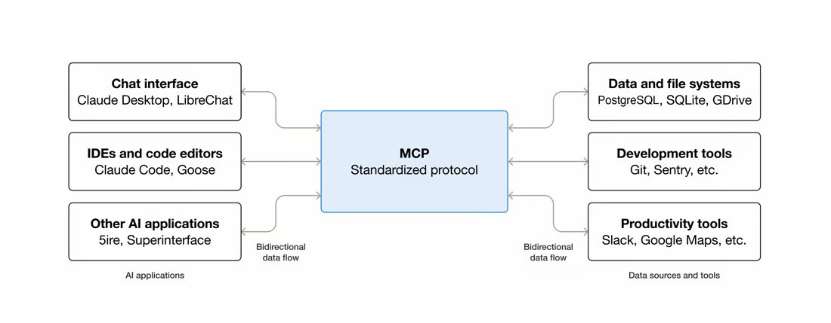
What is the Model Context Protocol (MCP)?
MCP is an open-source standard for connecting AI applications to external systems.
Think of MCP like a USB-C port for AI applications. Just as USB-C provides a standardized way to connect electronic devices, MCP provides a standardized way to connect AI applications to external systems

Slide 3
The Problem
Without MCP, every AI client—whether it's Claude Code, GitHub Copilot, Cursor, Claude Desktop, or a custom-built agent—needs a custom integration for every tool it wants to access. Connecting to Slack, GitHub, PostgreSQL, Google Drive, and other services requires separate code, creating a fragmented ecosystem filled with redundant integrations and ongoing maintenance overhead.
The MCP Solution
Build Once, Expose to All
Each tool simply exposes a standardized MCP server. Instead of building integrations for every AI application individually, tool providers implement MCP once and make their capabilities available to the entire ecosystem.
Plug-and-Play Connectivity
Any MCP-compatible AI client can instantly connect to any MCP-compatible server. Whether it's Claude Code, GitHub Copilot, Cursor, Claude Desktop, or a custom AI agent, they all speak the same protocol and can access the same tools without custom integrations.
Why It Matters
Instead of managing dozens of one-off connections, AI clients only need to understand one standard: MCP. This enables secure, scalable, and interoperable access to tools, databases, and services across the ecosystem.
MCP is the USB-C for AI: one standard connection that allows any compatible AI client to work with any compatible tool.

Slide 4
A Side-by-Side Comparison
Feature | The Web Ecosystem | The AI Ecosystem
The Standard | REST (HTTP / JSON) | MCP (Model Context Protocol)
The Provider | Backend API Server | MCP Server (e.g., GitHub MCP Server, Google calendar Mcp Server)
The Consumers | Web App, iOS App, Android App | Claude Desktop, LibreChat, Custom Agents
The Benefit | Frontends change, but the API stays the same. | AI models change, but the data source stays the same.

Slide 5
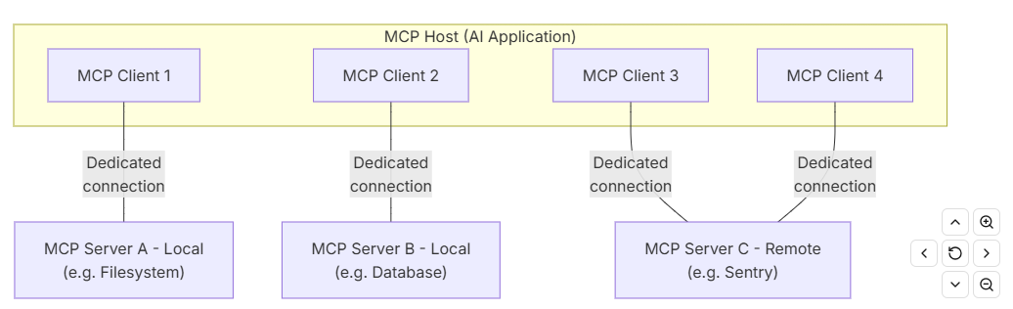
MCP Architecture
MCP Host: The AI application that coordinates and manages one or multiple MCP clients
MCP Client: A component that maintains a connection to an MCP server and obtains context from an MCP server for the MCP host to use
MCP Server: A program that provides context to MCP clients

Slide 6
MCP Architecture
MCP follows a client-server architecture where an MCP host — an AI application like Custom Agents or Claude Desktop — establishes connections to one or more MCP servers
The MCP host accomplishes this by creating one MCP client for each MCP server.
Each MCP client maintains a dedicated connection with its corresponding MCP server.
Local MCP servers that use the STDIO transport typically serve a single MCP client.
Remote MCP servers that use the Streamable HTTP transport will typically serve many MCP clients.
For example: Visual Studio Code acts as an MCP host. When Visual Studio Code establishes a connection to an MCP server, such as the Sentry MCP server, the Visual Studio Code runtime instantiates an MCP client object that maintains the connection to the Sentry MCP server. When Visual Studio Code subsequently connects to another MCP server, such as the local filesystem server, the Visual Studio Code runtime instantiates an additional MCP client object to maintain this connection.

Slide 7
Layers
MCP consists of two layers.
Data layer: Defines the JSON-RPC based protocol for client-server communication, including
lifecycle management, and core primitives, such as tools, resources, prompts and notifications.
Transport layer: Defines the communication mechanisms and channels that enable data exchange between clients and servers,
including transport-specific connection establishment, message framing, and authorization.

Slide 8
Data Layer
The data layer implements a JSON-RPC 2.0 based exchange protocol that defines the message structure and semantics.
This layer includes:
Lifecycle management: Handles connection initialization, capability negotiation, and connection termination between clients and servers
Server features: Enables servers to provide core functionality including tools for AI actions, resources for context data, and prompts for interaction templates from and to the client
Client features: Enables servers to ask the client to sample from the host LLM, elicit input from the user, and log messages to the client
Utility features: Supports additional capabilities like notifications for real-time updates and progress tracking for long-running operations

Slide 9
Transport Layer
The transport layer manages communication channels and authentication between clients and servers. It handles connection establishment, message framing, and secure communication between MCP participants.
MCP supports two transport mechanisms
:Stdio transport: Uses standard input/output streams for direct process communication between local processes on the same machine, providing optimal performance with no network overhead.
Streamable HTTP transport: Uses HTTP POST for client-to-server messages with optional Server-Sent Events for streaming capabilities.
This transport enables remote server communication and supports standard HTTP authentication methods including bearer tokens, API keys, and custom headers.
MCP recommends using OAuth to obtain authentication tokens.
The transport layer abstracts communication details from the protocol layer, enabling the same JSON-RPC 2.0 message format across all transport mechanisms.

Slide 10
MCP Primitives: Tools, Resources, and Prompts
MCP servers provide capabilities through three core primitives:
Tools
Actions the AI can perform.
Examples: Create a GitHub issue, Query a database, Send a Slack message
Resources
Data the AI can read and use as context.
Examples: Database schema, File contents, API responses, Documentation
Prompts
Reusable prompt templates that guide the AI.
Examples: Code review templates, Incident response workflows, Database analysis prompts
Together, these primitives give AI applications a standardized way to discover information, perform actions, and follow structured workflows.

Slide 11
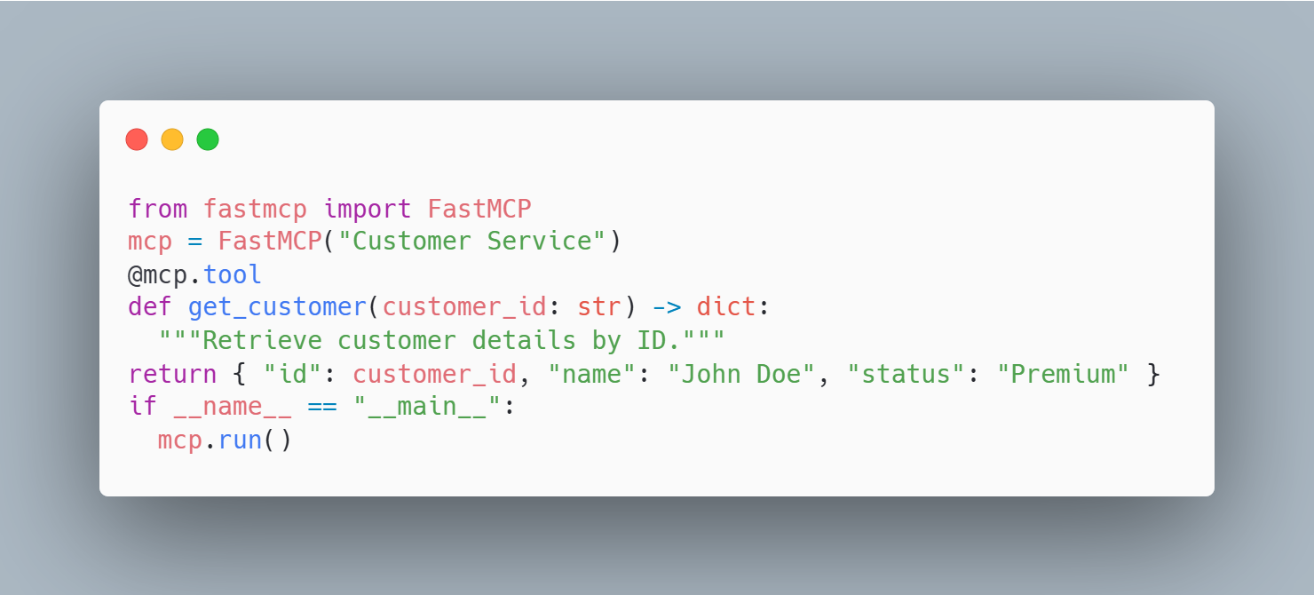
Tools
Tools allow AI clients to perform actions or execute business logic and ideal for
Database queries,
API calls,
Sending messages,
Creating tickets,
Running workflows
Example: Create a tool that retrieves customer information.
AI Usage:
User: Get customer CUST-123
AI → Calls get_customer("CUST-123")

Slide 12
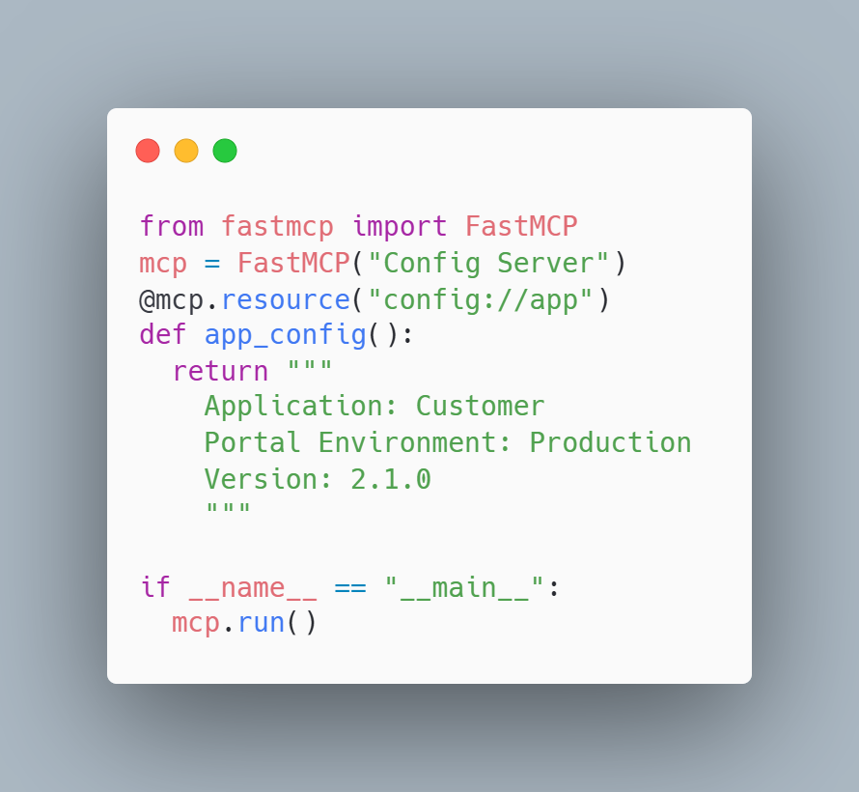
Resources
Resources expose data that AI clients can read and use as context. Database queries, ideal for:
Documentation
Configuration files
Database schemas
Knowledge bases
Static reference data
Example: Expose application configuration.
AI Usage:
Read resource: config://app

Slide 13
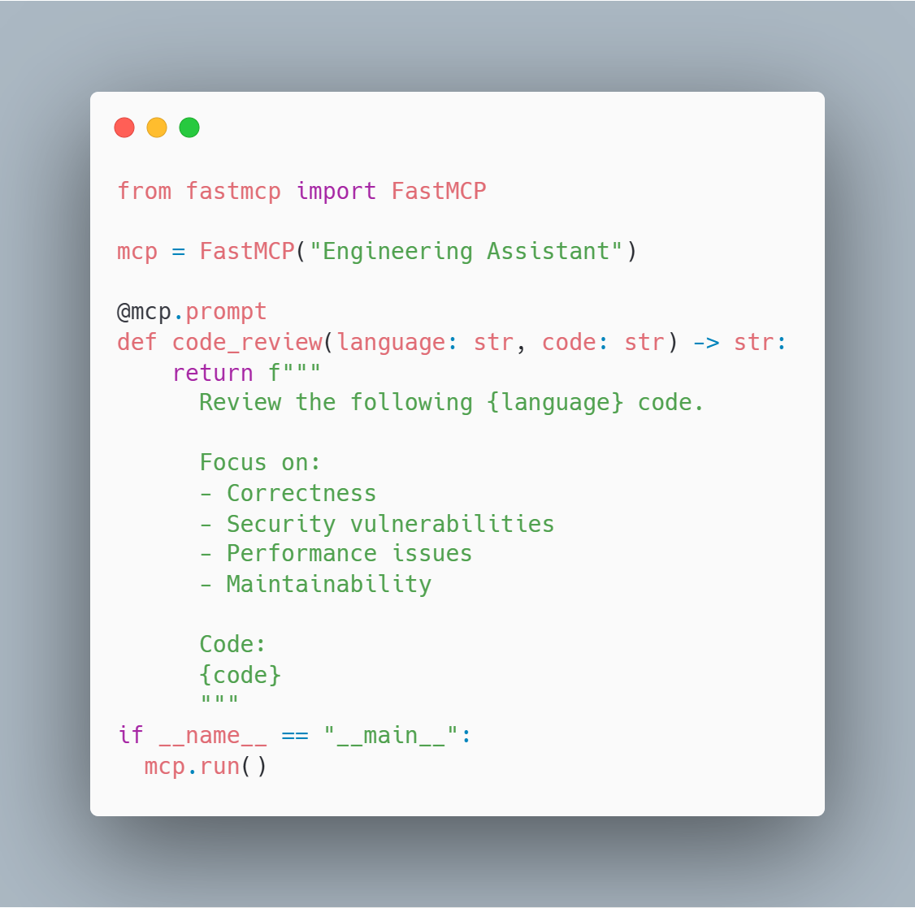
Prompts
Prompts provide reusable workflows and instructions. Documentation
Prompts are ideal for:
Code reviews
Incident investigations
Root cause analysis
Security assessments
Standardized business workflows
Example: Create a code review template.
AI Usage:
Use prompt: code_review

Slide 14
Summary of MCP Primitives
Primitive | Purpose | Example
Tool | Perform an action | Query PostgreSQL, create Jira ticket
Resource | Provide data/context | Documentation, schemas, config files
Prompt | Provide reusable instructions | Code review, incident response, security audit
Rule of Thumb:
Need the AI to do something? → Tool
Need the AI to read something? → Resource
Need the AI to follow a process? → Prompt

Slide 15
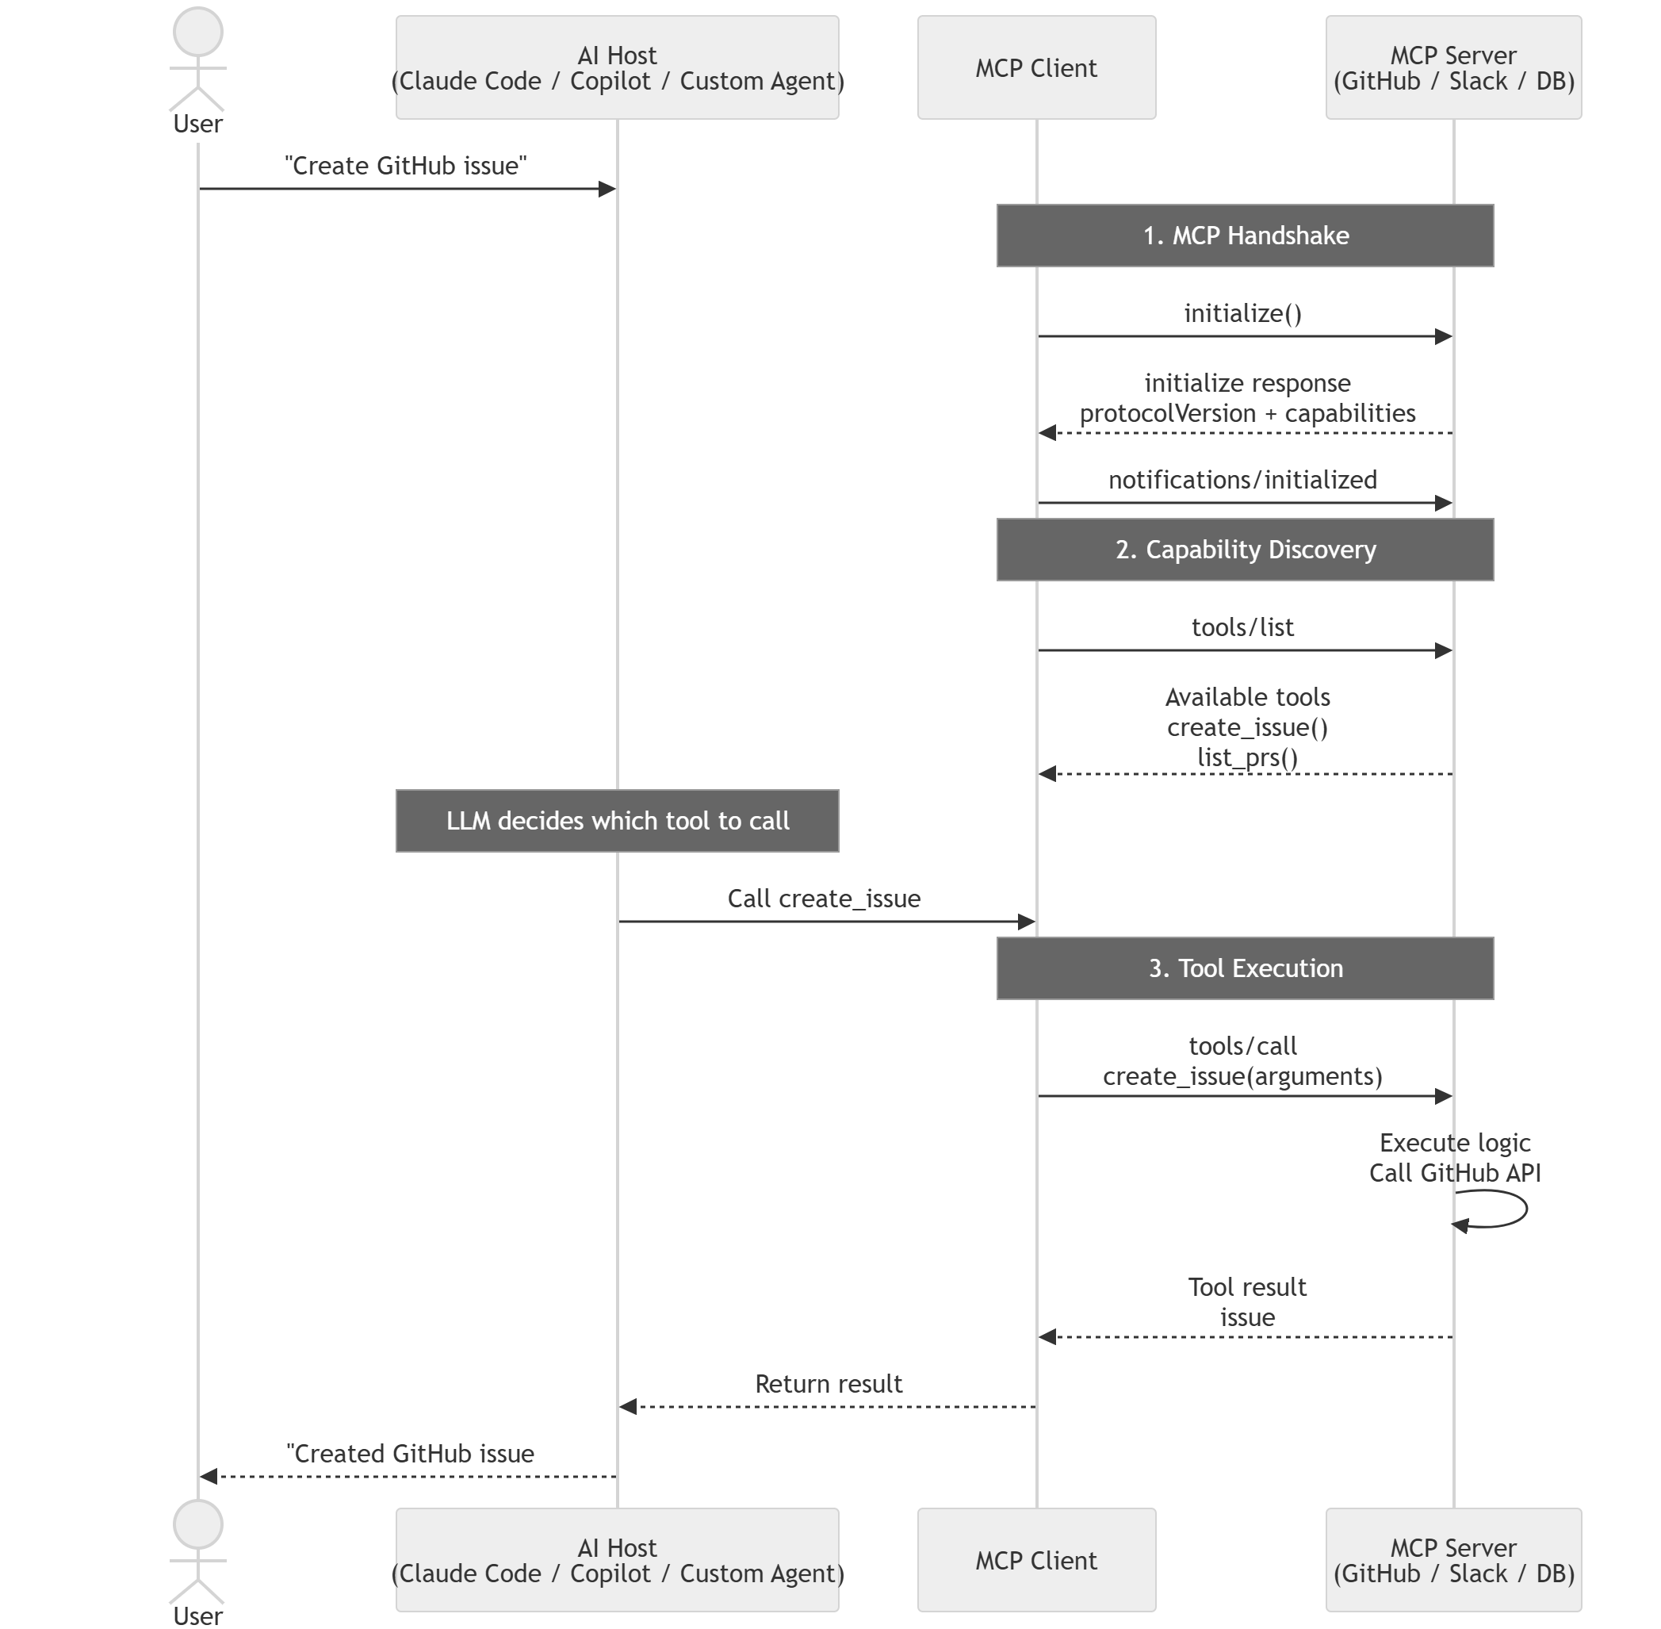
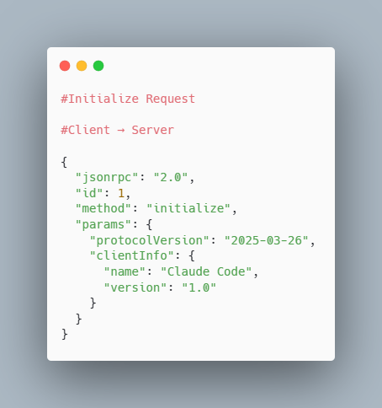
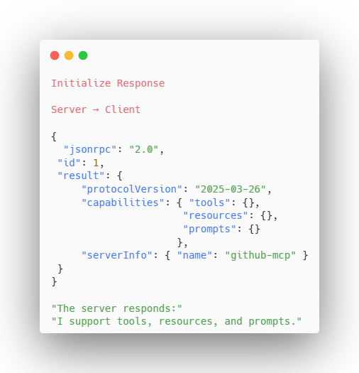
MCP Communication Lifecycle
Step 1: Connection & Initialization Before any tool can be used, the client and server perform a handshake.
The client introduces itself and asks:
"Can we communicate? What do you support?“ The client tells the server:
Who it is
Which MCP version it supports
What capabilities it has

Slide 16
MCP Communication Lifecycle
Step 2. Capability Discovery Once connected, the client asks: “What can you do?” Claude Code sends tools/list to the GitHub MCP Server. The server returns a catalog of available tools, including create_issue() and list_prs().
Step 2: Capability Discovery Once connected, the client asks:
"What can you do?"
Example:
Claude Code
|
| tools/list
|
v
GitHub MCP Server
Step 2. Capability Discovery Once connected, the client asks: “What can you do?” Claude Code sends tools/list to the GitHub MCP Server. The server returns a catalog of available tools, including create_issue() and list_prs().
● ● ●
● ● ●
● ● ●
● ● ●
#tools/list Request #Client → Server { "jsonrpc": "2.0", "id": 2, "method": "tools/list", "params": {} }
#tools/list Request #Client → Server { "jsonrpc": "2.0", "id": 2, "method": "tools/list", "params": {} }
tools/list Response Server → Client { "jsonrpc": "2.0", "id": 2, "result": { "tools": [ { "name": "create_issue" }, { "name": "list_prs" } ] } }
tools/list Response Server → Client { "jsonrpc": "2.0", "id": 2, "result": { "tools": [ { "name": "create_issue" }, { "name": "list_prs" } ] } }

Slide 17
MCP Communication Lifecycle
Step 3. User Request User: “Create a GitHub issue for the login bug.” The LLM decides: “I should call create_issue.” Important: The MCP server does not decide this. The LLM chooses which tool to call and what parameters to send.
Step 1: Connection & Initialization Before any tool can be used, the client and server perform a handshake.
The client introduces itself and asks:
"Can we communicate? What do you support?“ The client tells the server:
Who it is
Which MCP version it supports
What capabilities it has
Step 3. User Request User: “Create a GitHub issue for the login bug.” The LLM decides: “I should call create_issue.” Important: The MCP server does not decide this. The LLM chooses which tool to call and what parameters to send.
● ● ●
● ● ●
● ● ●
● ● ●
#User Intent #Host → MCP Client { "intent": "create issue", "selectedTool": "create_issue", "arguments": { "title": "Login bug", "body": "Users cannot sign in", "labels": ["bug"] } }
#User Intent #Host → MCP Client { "intent": "create issue", "selectedTool": "create_issue", "arguments": { "title": "Login bug", "body": "Users cannot sign in", "labels": ["bug"] } }
Decision Result MCP Client Ready { "readyToCall": true, "method": "tools/call", "name": "create_issue", "nextStep": "invoke server" }
Decision Result MCP Client Ready { "readyToCall": true, "method": "tools/call", "name": "create_issue", "nextStep": "invoke server" }

Slide 18
MCP Communication Lifecycle
Step 4. Tool Invocation The server: • Receives request • Validates input • Executes logic • Calls external API/database • Returns result
Step 1: Connection & Initialization Before any tool can be used, the client and server perform a handshake.
The client introduces itself and asks:
"Can we communicate? What do you support?“ The client tells the server:
Who it is
Which MCP version it supports
What capabilities it has
Step 4. Tool Invocation The server: • Receives request • Validates input • Executes logic • Calls external API/database • Returns result
● ● ●
● ● ●
● ● ●
● ● ●
#tools/call Request #Client → Server { "jsonrpc": "2.0", "id": 3, "method": "tools/call", "params": { "name": "create_issue", "arguments": { "title": "Login bug", "body": "Users cannot sign in" } } }
#tools/call Request #Client → Server { "jsonrpc": "2.0", "id": 3, "method": "tools/call", "params": { "name": "create_issue", "arguments": { "title": "Login bug", "body": "Users cannot sign in" } } }
tools/call Response Server → Client { "jsonrpc": "2.0", "id": 3, "result": { "content": [{ "type": "text", "text": "Created issue #123" }], "isError": false } }
tools/call Response Server → Client { "jsonrpc": "2.0", "id": 3, "result": { "content": [{ "type": "text", "text": "Created issue #123" }], "isError": false } }

Slide 19
MCP Communication Lifecycle
Step 5. Tool Response The MCP client gives the result back to the LLM. The response is structured tool output, so the model can reference the actual issue number and status in the next turn.
Step 1: Connection & Initialization Before any tool can be used, the client and server perform a handshake.
The client introduces itself and asks:
"Can we communicate? What do you support?“ The client tells the server:
Who it is
Which MCP version it supports
What capabilities it has
Step 5. Tool Response The MCP client gives the result back to the LLM. The response is structured tool output, so the model can reference the actual issue number and status in the next turn.
● ● ●
● ● ●
● ● ●
● ● ●
#Result Propagation #MCP Client → LLM { "role": "tool", "toolName": "create_issue", "toolCallId": 3, "content": "Created issue #123" }
#Result Propagation #MCP Client → LLM { "role": "tool", "toolName": "create_issue", "toolCallId": 3, "content": "Created issue #123" }
LLM Acknowledges Ready to Answer User { "observed": { "issueNumber": 123, "title": "Login bug", "status": "created" }, "nextStep": "final response" }
LLM Acknowledges Ready to Answer User { "observed": { "issueNumber": 123, "title": "Login bug", "status": "created" }, "nextStep": "final response" }

Slide 20
MCP Communication Lifecycle
Step 6. Final AI Response The LLM responds to the user in plain language: “Created GitHub issue #123 for the login bug.” The final response summarizes the tool outcome without exposing the full JSON-RPC exchange.
Step 1: Connection & Initialization Before any tool can be used, the client and server perform a handshake.
The client introduces itself and asks:
"Can we communicate? What do you support?“ The client tells the server:
Who it is
Which MCP version it supports
What capabilities it has
Step 6. Final AI Response The LLM responds to the user in plain language: “Created GitHub issue #123 for the login bug.” The final response summarizes the tool outcome without exposing the full JSON-RPC exchange.
● ● ●
● ● ●
● ● ●
● ● ●
#LLM Response Draft #AI Host { "source": "tool result", "issue": { "number": 123, "title": "Login bug" }, "userMessage": "Created GitHub issue #123" }
#LLM Response Draft #AI Host { "source": "tool result", "issue": { "number": 123, "title": "Login bug" }, "userMessage": "Created GitHub issue #123" }
Final User Message AI Host → User { "message": "Created GitHub issue #123 for the login bug.", "complete": true }
Final User Message AI Host → User { "message": "Created GitHub issue #123 for the login bug.", "complete": true }

Slide 21
MCP Transports — How MCP Clients and Servers Communicate
Why Do We Need a Transport Layer?
MCP defines what messages are exchanged between an AI client and a server.
Examples:
initialize
tools/list
tools/call
resources/read
But MCP does not assume where the server runs.
The server could be: a local process on the developer machine
a service running in Kubernetes a remote enterprise service
The transport layer defines how these MCP messages travel.
+-------------+
| MCP Message |
| (JSON-RPC) |
+-------------+
|
|
+----------------+
| Transport |
+----------------+
/ \
/ \
STDIO HTTP

Slide 22
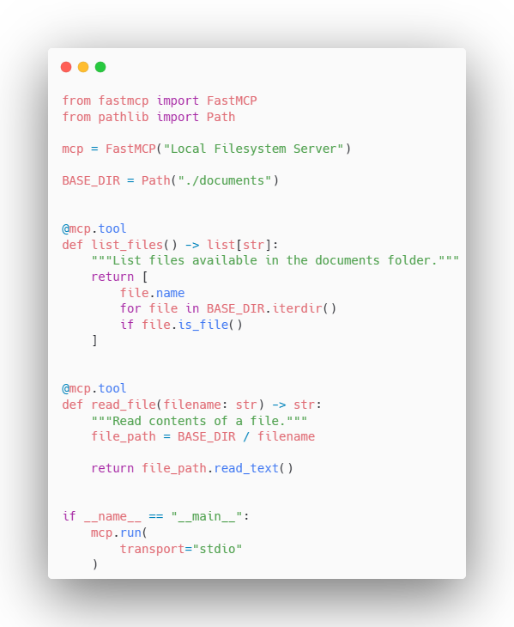
Transport 1: STDIO
Local Process Communication
STDIO is designed for local MCP servers.
The MCP client launches the server as a child process and communicates through:
stdin → requests
stdout → responses
Characteristics:
Client launches server process
No network
No port
OS permissions control access
No TCP connection.
No port.

Slide 23
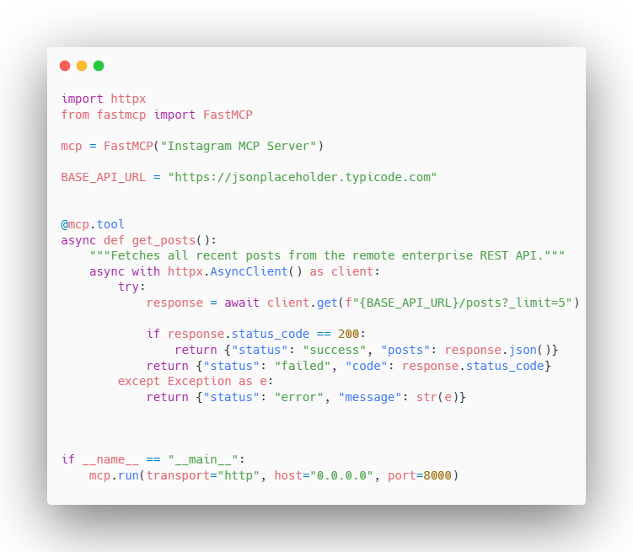
Transport 2: HTTP
HTTP is used when the MCP server is deployed as a service.
Examples:
company-wide MCP server
Kubernetes deployment
cloud hosted MCP platform
Characteristics:
Server runs independently
Multiple clients can connect
Requires authentication & authorization

Slide 24
When to Use STDIO vs HTTP Transport
Use Case | STDIO | HTTP
Server location | Runs locally on the same machine | Runs remotely as a service
Communication | Process stdin/stdout | Network (HTTP)
Best for | Developer tools, personal assistants, IDE integrations | Enterprise/shared MCP platforms
Users | Usually single user | Multiple users / teams
Deployment | Simple process launch | Service deployment
Scaling | Not designed for horizontal scaling | Can scale like any API service
Security | OS permissions + local access | Authentication + authorization required
Latency | Very low | Network latency
Availability | Depends on local machine | Can be highly available
Use STDIO for developer-local integrations. Use HTTP for scalable, secure, multi-user MCP deployments.

Slide 25
Assignment
Build a mcp server from this example https://modelcontextprotocol.io/docs/develop/build-server Use the boilerplate code from the below repo to use langchain mcp adapter code instead of claude code or vscode copilot as mcp host https://github.com/Mike00028/mcp-weather-app

Slide 26
Commonly Asked Questions

Slide 27
What is MCP?
MCP (Model Context Protocol) MCP is an open-source standard for connecting AI applications to external systems. Example connecting AI applications to external data sources, tools, rest api services.

Slide 28
How does an MCP server work?
It operates on a standardized client-server architecture.
The MCP Host : The AI application (like Custom AI application, Claude Desktop, Copilot, ). *Mcp Client is network architecture. It initiates the connection to the MCP Server, sends requests, and handles the responses
The MCP Server: A lightweight, local or remote application that exposes its capabilities to the AI
The Capabilities: The server provides three main things:
Tools: Actions the AI can take (e.g., executing a database query, creating a Jira ticket).
Resources: Data streams or read-only files loaded into the AI's context (e.g., API documentation, logs).
Prompts: Pre-defined templates for specific AI workflows.

Slide 30
Why json rpc: https://medium.com/@dan.avila7/why-model-context-protocol-uses-json-rpc-64d466112338

